Slide 1
Site (e.g., LARC Embakasi)
[Identify which Viral Load Cascade component your project addresses
(e.g. Demand Creation)]
Speaker Name, Title,
Organization
Date

Slide 2
Country Team
List the members of the team & team member roles
  Include photo of LARC team

Slide 3
Facility Selected/Information / Background
Photo here if possible
Brief description of the facility - # of patients on ART, etc.

Slide 4
Stakeholder Analysis
Display which one of the two tools used

Slide 5
The Story of Our Project

Slide 6
Project Summary
What are we trying to accomplish? | How will we know if a change is an improvement? | What change will we make that will result in an improvement?
Overarching Goal | AIM Statement Improve (increase, decrease) _______ (metric) from _____ to ____ by ________ (date). Metric: (specify numerator and denominator) | Intervention [Describe the PDSA/s (test/s of change) that you tested]

Slide 7
Elevator Speech
This project is about _________________________________________
As a result of these efforts, (What will your project actually accomplish)
It’s important because we are concerned about:
___(Big Picture Here)_________________
____________________
Success will be measured by showing improvement in:
____________________
____________________
What we need from you –
___(Describe to whom you are presenting the “ask”) What do you need from this person? Or organization?___________________________

Slide 8
Process Mapping
The First Step Towards Improvement
(Show your process map. Use any format that you have learned - chart, swim lanes, photo of sticky notes on paper. Highlight the area/s for improvement)

Slide 9
Process Mapping
The First Step Towards Improvement
(Show your process table. Provide sufficient detail of the entire process. Highlight the area/s for improvement.)
Process Step | What Happens? | Who is responsible? | Duration | Forms/logs | Opportunity for Improvement

Slide 10
Define
Measure
Analyze
Improve
Control
Gap (Problem Statement):
  Share your problem – (in 15 words or less, if possible)
Notes:
10
10

Slide 11
Define
Measure
Analyze
Improve
Control
Voice of Customer (VOC)
  Who is your customer? (patients, health care workers) Did you select the right customer for your identified problem?
  Tool used to collect the VOC (survey, focus group)
  Collection Process (# surveyed, method surveyed)
  Results (Display)
  What did you learn? How did you apply what you learned in your intervention?
Notes:
11
11

Slide 12
Define
Measure
Analyze
Improve
Control
Metric Selected
  Numerator/Denominator
Baseline Data
  Give percentage/number
Notes:
12
12

Slide 13
Define
Measure
Analyze
Improve
Control
Data Collection Process
  Data Collection Tool
    List or insert picture (if available) of any data collection tool that was used for your project
  Data Collection Plan
    How many data points for baseline?
    Timeframe of data collection. How frequently did you collect your data? – baseline & project data?
Notes:
13
13

Slide 14
Define
Measure
Analyze
Improve
Control
Materials / Supplies
People
Process
Problem
Environment
Policy /
Procedure
Equipment
Root cause - insert picture/diagram of your fishbone diagram or other tool used.
Circle your root cause
Notes:
14
14

Slide 15
Define
Measure
Analyze
Improve
Control
IMPACT / EFFORT GRID A Tool for Prioritizing Opportunities
Projects - Detailed planning and work
Major
Improvement
Just Do It
IMPACT
Just Do It if Impactful
Maybe some day
Minor
Improvement
Easy to Do
Difficult to Do
EFFORT

Slide 16
Define
Measure
Analyze
Improve
Control
Just Do Its
  Include lists and/or photos of Just Do Its completed
Notes:
16
16

Slide 17
Define
Measure
Analyze
Improve
Control
Small Test of Change (PDSA #1)
ACT
PLAN
DO
STUDY
PDSA – Describe in Detail your PDSA. Did you Adopt, Adapt or Abandon?
Notes:
17
17

Slide 18
Define
Measure
Analyze
Improve
Control
Small Test of Change (PDSA #2)
ACT
PLAN
DO
STUDY
PDSA – Describe in Detail your PDSA. Did you Adopt, Adapt or Abandon?
Notes:
18
18

Slide 19
Challenges
Share challenges; What did the team do to address the challenges?
Challenges
Address challenges

Slide 20
Lessons Learned
What did the team learn? Reflect on what you will do differently in the future.

Slide 21
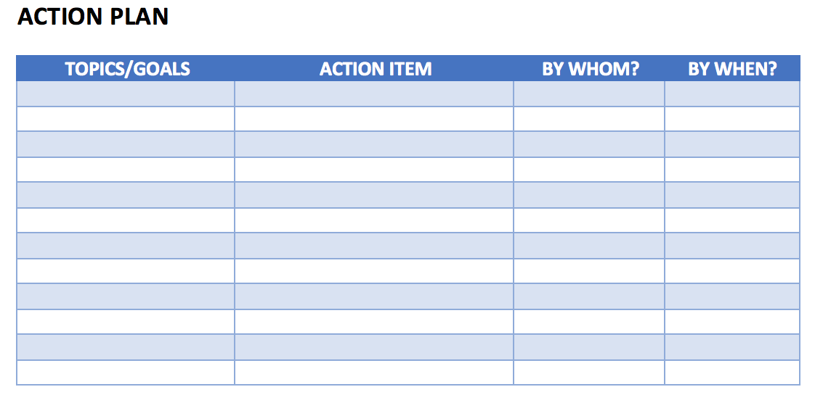
Action Plan
Action Plan – Share your action plan, if you have
any additional actions to complete

Slide 22
Learning Session #2 Presentation
Focus of Your Presentation – New Deliverables
  Make It a Story; Connect every tool to your project
  Summary (Slide #6) – Clearly articulate your test of change as a process change
  VOC (Slide #11) – Focus on bolded question – what you learned will drive your interventions - PDSAs/Small tests of change
  Baseline Metrics (Slide # 12 & 13) – Collect and understand baseline data
  Root Cause Analysis (Slide # 14) – Clearly identify your root cause, then your root cause will drive your interventions – PDSAs/Small tests of change
  Just Do Its – (Slide # 16) – Based on what you identified in your process mapping and put in the upper left quadrant on your impact/effort grid (Slide # 15)
  1 Test of Change (PDSA) (Slide #17 & 18) – select your first test of change based on your root cause & the information that you learned in your VOC
  Update Previous Items (See Deliverables – Slide #23)

Slide 23
Session 1 Deliverables
DEFINE / MEASURE / ANALYZE
Identify Stakeholders
Team Formation
Map the Process (Current)
ID / Prioritize Opportunities
  Project Outline
Baseline Metrics - Data Collection Tool/Plan
Action Plan
Elevator Speech
VOC Information
Root Cause Analysis
1 Rapid/Small Test of Change (PDSA)
Presentation

